Slide 1
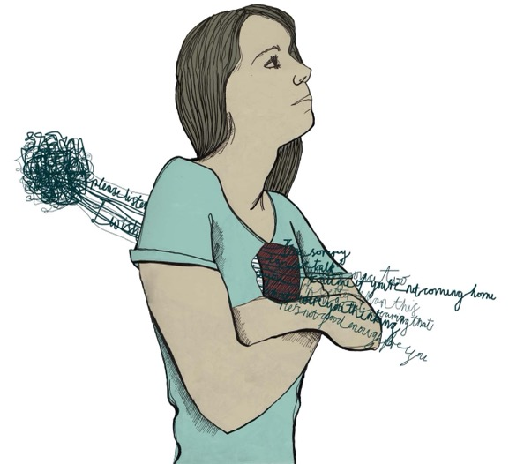
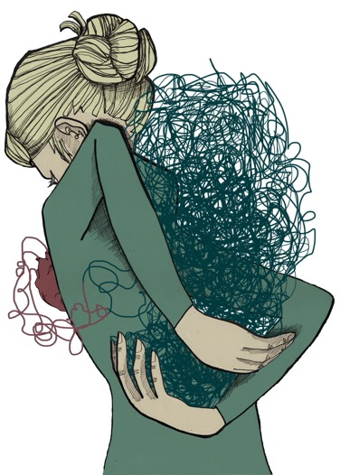
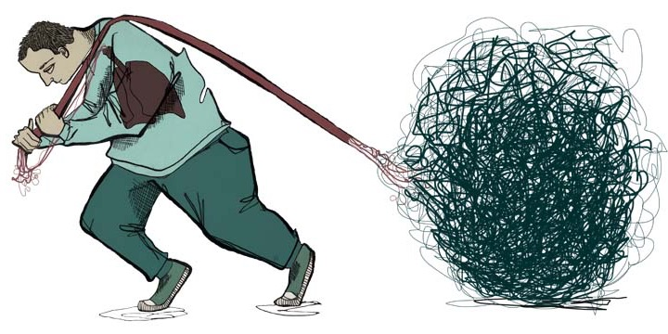
Session 2: My Emotions
Notes:
For more information for professionals on emotions for to SCCR Website > Learning Zone > Professionals > Emotions to find guided powerpoints and articles.

Slide 2
Learning Objectives:
Name the three elements that make up an emotion
Recognise emotions in yourself and others
Explain why emotions are important
Describe the window of tolerance
Name the 5 stages of the emotional arousal cycle
State the difference between primary and secondary emotions
Notes:
Overall Lesson Aim: To increase understanding of emotions and emotional regulation.

Slide 3
What are emotions?
Notes:
There are many different types of emotion and we can experience more than one at once.
They are different from emotional states and we can feel multiple emotions in one emotional states, or sometimes be in different emotional states when we experience one emotion. For example, when we are in fight or flight we might feel angry, afraid and rejected all at once. But feeling angry doesn’t mean that we will always be in fight or flight, sometime we stay in complete control, Alert and Engaged, sometimes we’re so angry we freeze and shutdown. It is a fluid process.
Discussion: how would you describe an emotion? (ask pupils to come up with a definition)

Slide 4
Three parts of an emotion:
Subjective Experience:
Experienced uniquely based on past experiences and the wider context.
2. Physiological Response:
Trigger sensations in our body (e.g. changes in breathing and temperature).
3. Behavioural response:
Trigger automatic behaviours (e.g. facial expressions or involuntary movements).
Notes:
Subjective experience is how you personally experience the emotion. This is sometimes called the cognitive component because you interpret a situation or event based on previous experience and context, to identify the way you are feeling.
Physiological responses are involuntary bodily responses controlled by the sympathetic nervous system. These include changes in temperature, heart rate, breathing, sweating etc.
Similarly, the behavioural response is a movement or expression that happens automatically, like gasping, laughing or stepping back.
Example Scenario:
You are walking down the street and a dog runs up to you. Your brain process the situation in the current context and in relation to past experiences. It is just starting to get dark and you didn’t see the dog coming. It doesn’t appear to be on a lead, and you don’t recognise the owner. When you were young you were bitten by a dog. You recognise that what you are feeling is fear. This is your subjective experience of an emotion.
Your brain responds to this message by producing a physiological response. Your hands begin to sweat and your heart is racing.
You yell out and take a few steps back from the dog, your eyes wide. This is your behavioural and expressive response. The emotion, fear, has acted as a message to tell the brain that you may be in danger so that it can prepare you to respond quickly.

Slide 5
Optional Activity
Emotion Ball
Pass the ball and take it in turns to:
Name the emotion
Name a physiological response
Name an automatic behaviour response
(Class Activity B1)
Notes:
The aim of this activity is to get pupils to think about the three elements of an emotion. Make it clear that there are no right or wrong answers as emotions are subjective. Try to encourage them to think about the difference between a body sensation and a behaviour response (this could include a facial expression).
Read out a scenario then throw the ball to a pupil and ask them to shout out what emotion they would feel before throwing the ball back.
Throw the ball to the next pupil and ask them to shout out something they would feel in their body (Physiological Response) before throwing the ball back.
Throw the ball to the next pupil and ask them to shout out an automatic behaviour they might do before throwing the ball back.
Repeat with different scenarios.

Slide 6
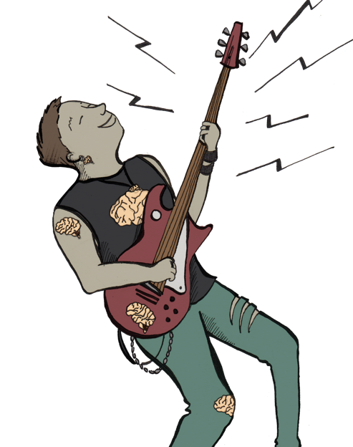
Recognising Emotions
1. Happiness
Things we feel
Lightness
Warmth in chest
Butterflies in stomach
Changes in breathing
Increased heart rate
Things we see
Happy tears
Jumping/being energetic
Lifted posture
Upbeat tone of voice
Pupils dilated
Notes:
We all experience emotions differently, but these are some examples of physiological and behavioural response that might happen.

Slide 7
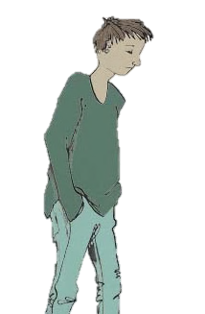
Recognising Emotions
2. Sadness
Things we feel
Heaviness
Tight chest
Sinking feeling in stomach
Tiredness
Sickness
Lump in throat
Things we see
Tears
Furrowed brows
Slumped posture
Comfort habits
Withdrawal
Low voice
Notes:
We all experience emotions differently, but these are some examples of physiological and behavioural response that might happen.

Slide 8
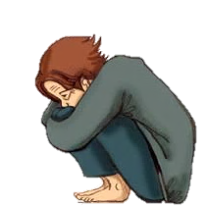
Recognising Emotions
3. Worry
Things we feel
Increased heart rate
Dizziness
Increased sweating
Shallow rapid breathing
Churning stomach/nausea
Weak muscles
Things we see
Trembling/shaking
Wide eyes
Shrinking posture
Comfort habits
Goosebumps
Jumpiness
Notes:
We all experience emotions differently, but these are some examples of physiological and behavioural response that might happen.

Slide 9
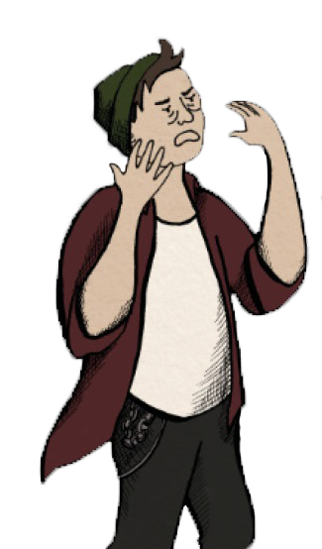
Recognising Emotions
4. Anger
Things we see
Red face
Clenched jaw or fist
Fidgeting/shaking
Raised voice
Lowered eyebrows
Puffed out chest
Pursed lips
Nostrils flared
Things we feel
Racing heart
Tense muscles
Sweating
Churning stomach
Tight chest
Fast breathing
Hotness
Notes:
We all experience emotions differently, but these are some examples of physiological and behavioural response that might happen.

Slide 10
Activity
Draw How You Feel
Choose an emotion (anger, worry or sadness) and think about how it feels in your body. Draw or label the person outline.
Hint: Think about your breathing, temperature and facial expressions as well as how it feels in your chest, stomach and muscles.
(Workbook Activity 2a)
Notes:
This can be done individually or in groups.
Ask the pupils to choose an emotion they would like to explore (or assign them either happy, sad, scared/anxious, or angry) and get them to write it above their person outline.
Ask pupils to draw in the person outline what happens in the body when they experience that emotion
If they are struggling to be self reflective ask them to think about what they might notice if they saw someone else experiencing that emotion
You can prompt them by suggesting they think about things such as: heartrate, temperature, facial expression, changes in complexion, changes in muscle tension, sensations in the chest and stomach (use slides above for ideas).
Go through some of the emotions as a class and share ideas.

Slide 11
Facial Expressions
Research found 7 emotions that have universal facial expressions regardless of race, gender, culture or any other variable.
These expression are called micro-expressions. They are automatic facial responses that happen very quickly.
Surprise
Contempt
Disgust
Joy
Sadness
Anger
Fear
Notes:
As well as using some of the physiological and behavioural responses we’ve looked at so far to identify other people’s emotions, we can also use facial expressions.
Although we all experience emotions uniquely, research has found that there are 7 primary emotions that have universal facial expressions that look the same regardless of race, culture, nationality, gender, religion, or any other variable.
These facial expressions are called micro-expressions. They are automatic and we can’t control them. They can happen very quickly and sometimes they are difficult to spot.
Ekman, P., Sorenson, E. R., & Friesen, W. V. (1969). Pan-cultural elements in facial displays of emotion. Science, 164(3875), 86-88. https://doi.org/10.1126/science.164.3875.86

Slide 12
Activity
Facial Expression Quiz
Match the micro-expressions to the emotion words.
(Workbook Exercise 2.1)
Notes:
This can be done individually in the activity workbook or using the following slide.

Slide 13
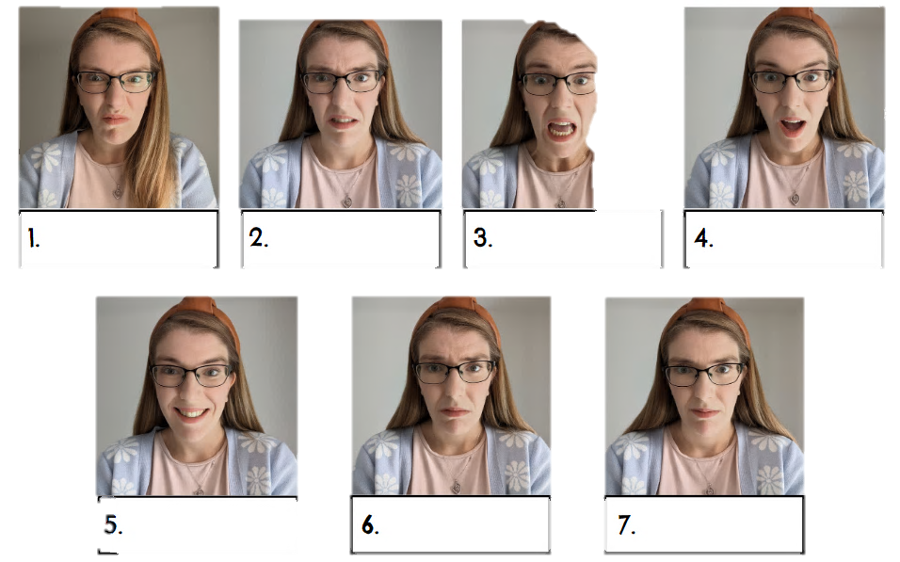
Match the emotion to the micro-expression
Joy
Sadness
Surprise
Anger
Fear
Contempt
Disgust
Notes:
Ask students to complete the quiz on a bit of paper or in their workbook.
Answers:
1. Anger – eyebrows pulled down and together, eyes opened wide, lips pressed tightly together
2. Disgust – lowered eyebrows, wrinkling on the side of the nose, upper lip raised to u shape
3. Fear – eyebrows pulled together, raised upper lip, tensed lower eyelids, jaw dropped and lips stretched
4. Surprise – eyebrows raised, neutral eyelids, jaw dropped down
5. Joy – eyes narrowed and wrinkling, cheeks raised, teeth exposed in a smile
6. Sadness – Inner corners of eyebrows pulled up and together, top eyelids drooped, lip corners pulled down.
7. Contempt – Corner of lip pulled up
These are the markers for micro-expressions based on Paul Ekman's research and muscle mapping of the face.

Slide 14
Optional Activity
Emotion words
Match the micro-expressions to the emotion words.
(Workbook Activity 2b)
Notes:
In groups or individually
Set a timer for 1 minute and ask students to write down as many emotion words as they can think of in that time.

Slide 15
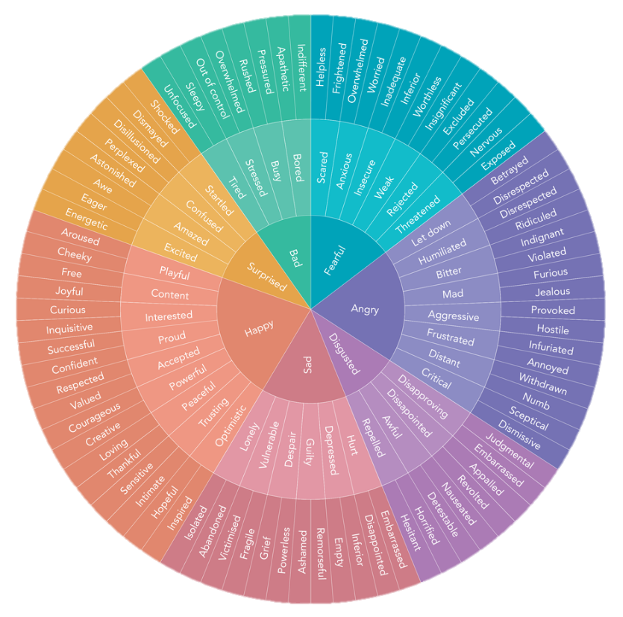
The Feelings Wheel
A tool to help identify and communicate our emotions.
Identifying emotions accurately helps us understand what they are telling us and what we need.
Are there any words you don’t know??
Notes:
We can use the words and pictures to identify how we are feeling and express this for ourselves and to others.
The Feelings Wheel was created by Dr. Gloria Willcox as a tool to help identify and communicate our emotions more accurately. The wheel is divided into primary emotions, secondary emotions and tertiary emotions. The primary emotions are in the centre of the wheel and are more general emotions. The further from the centre you go, the more detailed and specific the emotions become.
You can use the wheel when you are not sure what emotion you are feeling. Start by noticing in your body how you feel and take a few breaths. Scan the wheel to see if any words jump out at you. If you’re not sure, start by choosing an emotion in the centre of the wheel. Then explore all of the emotion words in that colour segment and find the emotion word that best suits your feeling.
The more accurately we can describe how we are feeling the easier it is to figure out what the emotion is telling us and what we need.
Ask the class if there are any words they have not heard before and go through these.
Further information: https://www.calm.com/blog/the-feelings-wheel

Slide 16
Why are Emotions Important?
Emotions carry information to the brain, like messages. Often, they are making us aware of a need that is not being met.
Emotions make us aware of what is important to us in a situation and help guide our actions and decision making.
Notes:
Emotions carry information to the brain, like messages. Often, they are making us aware of a need that is not being met.
Emotions make us aware of what is important to us in a situation and help guide our actions and decision making.

Slide 17
Activity
Messages to the Brain
Fill in the missing Emotion, Message or Action. What is the emotion telling us and what might we need to do in response?
(Workbook Activity 2c)
Notes:
The purpose of this activity is to get pupils linking their emotions to their needs. It encourages them to think about what an emotion might be telling them and how they could respond to it.

Slide 18
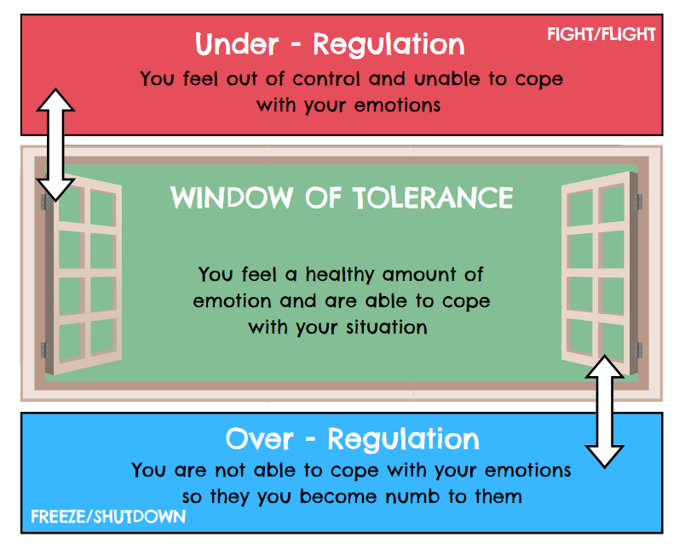
Window of Tolerance
When we are in our green zone, we feel able to cope with our emotions.
Our window of tolerance can grow and shrink depending on who we are with, our past experiences, and what’s going on in our life
Notes:
While there is no such thing as a bad emotion, emotions can become unhelpful if they are over-regulated or under-regulated. When we are able to cope with our emotions in a healthy way, we call this our "window of tolerance“ or our green zone. If our emotions become too much and we are no longer able to cope we move into our "red zone" where our emotions are under-regulated. We might go into our fight or flight mode. If our emotions are not active enough, we might move into our "blue zone", where our emotions are over-regulated. This means they are regulated so much that we might not feel anything at all. We might go into our freeze and shutdown mode.
Our window of tolerance can grow and shrink depending on who we are with, what's going on in our life, our past experiences and how much sleep we've had. There are lots of things we can do to help regulate our emotions, which we will look at in Lesson 3.

Slide 19
Emotions and Behaviour
Anger
A healthy emotion that we can choose to release and express in a positive way
Aggression
An unhelpful behaviour that can come from anger, often involving force or violence.
VS
Notes:
Emotions also give us behavioural urges. These are different than the automatic behavioural responses such as facial expressions and involuntary movements. Behavioural urges such as shouting or throwing something are in our control, although it may not always feel like it, especially if our Lizard brain is active.
Anger = a healthy emotion that we can choose to release and express in a positive way
Aggression = an unhelpful behaviour that can come from anger, often involving force or violence. Aggression is in our control and we can learn ways to deal with our anger in a more positive and healthy way.

Slide 20
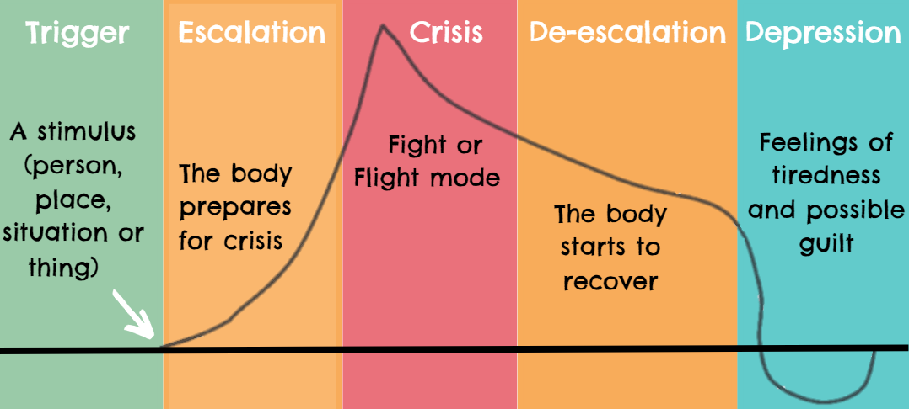
Emotional Arousal Cycle
Notes:
The Emotional Arousal Cycle shows a pattern that often happens when we become overwhelmed by our emotions. In the Crisis phase we struggle to control our behavioural urges.
If we have experienced stress or trauma we may be triggered more easily, escalate more quickly, stay in crisis for longer, find it harder to de-escalate, and take longer to recover after.
If we can learn what things can trigger certain emotions, what escalation looks and feels like, we can come up with coping strategies to stop ourselves from reaching the crisis phase.

Slide 21
Activity
Triggers and Warning Signs
Write done what situations/things cause you to feel frustrated or overwhelmed. Write down how you feel and act in each stage of the Emotional Arousal Cycle.
(Workbook Activity 2d)
Notes:
Ask pupils to fill in the trigger box in Activity 2d with things that trigger emotions for them. It might be situations, places or things that cause them to feel frustrated, anxious or overwhelmed.
Then ask them to think about how they feel in each stage of the emotional arousal cycle. This is about getting them to recognise when they are in the escalation phases so that we can learn to prevent the crisis stage.
Example: Getting Angry
Escalation:
Feelings - hotness, frustration, increased heart rate, increased sweating.
Behaviour – fidgeting, clenching teeth
Crisis:
Feeling: tight muscles, overwhelmed, rage, energy
Behaviour – shouting, swearing, storming away
De-escalation:
Feeling - Calming down, heart rate slowing, starting to breath deeper
Behaviour – sitting down, relaxing more, going quiet
Depression:
Feeling – tired, regretful, guilty
Behaviour – rest, make amends, sit still

Slide 22
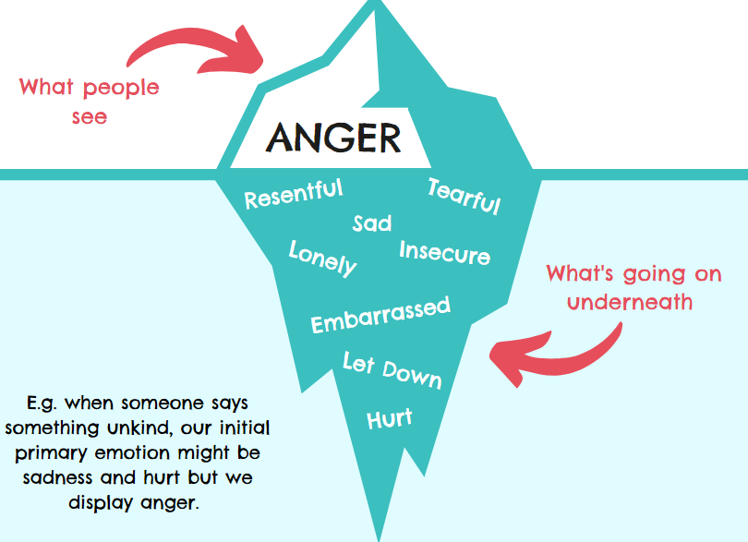
Primary Vs Secondary Emotions
Primary Emotions are raw and instinctive.
Secondary Emotions are felt in response to primary emotion.
Notes:
There are two types of emotions, primary and secondary.
Primary emotions = The first emotion we feel when something happens; raw, instinctive emotion; usually accompanied with a sensation in the body and behaviour response.
Secondary = Felt after in response to the primary emotion; usually learnt or experienced out of habit; can mask the primary emotion.
Sometimes we only see the secondary emotion and we have to go back and figure out what our primary emotions were to understand how we are feeling. Like an iceberg, we can only see what’s on the surface but there is much more going on underneath.
E.g. when someone says something unkind, our initial primary emotion might be sadness and hurt but we display anger.

Slide 23
Optional Activity
Emotion Iceberg
Choose an emotion such as anger, sadness or worry and write it in the tip of the iceberg. Now think of a time you have felt that way and write down all the other possible emotions that were behind that feeling.
(Workbook Activity 2e)
Notes:
The purpose of this activity is to get pupils to think about how sometimes our emotions are masked by a secondary emotion such as anger. When we are feeling strongly it can be helpful to identify all the different emotions going on and find out what is behind emotions such as anger and sadness. Encourage pupils to use the feelings wheel to complete this exercise
Pupils can also use this worksheet as part of the next activity and fill it in from the perspective of either Sammy or Kerry and explore what is behind their anger.

Slide 24
Activity
Sammy and Kerry
Read through your characters backstory and discuss the questions on the worksheet?
(Class Activity B2)
Notes:
The purpose of this exercise is to get pupils looking at primary emotions behind anger in a practical scenario. It encouraged pupils to think about the other perspective and empathise more.
Instructions:
Split the class into 2 groups and assign each group a character (Sammy and Kerry)
Give each group a copy of their character’s backstory and the first worksheet.
Read the main scenario to the class.
Ask the groups to read through their characters backstory.
Then ask the groups to fill in the rest of the worksheet and think about what other emotions are behind the argument and how they might express their feelings to the other person.
Assign 1 pupil from each group as the character. They are going to explain to the other group: what is going on in their life, how it is making them feel and how they think it has affected the argument (use worksheet as prompt).
Facilitate a roleplay and encourage the groups to offer suggestions of how to resolve the argument.
Ask pupils to go back into their group and discuss how their perspective has changed now they know more about what is going on. Hand out the second worksheet to each group and ask them to discuss and complete the questions.
Discuss as a class how the roleplay went and what they have learnt.

Slide 25
Learning Objectives:
Name the three elements that make up an emotion
Recognise emotions in yourself and others
Explain why emotions are important
Describe the window of tolerance
Name the 5 stages of the emotional arousal cycle
State the difference between primary and secondary emotions
Notes:
Emotions are made up of: the subjective experience, the physiological response, and the behavioural response.
Sensations in the body like breathing, heart rate, sweating, temperature and muscle tension can help us recognise our emotions. Behavioural responses like facial expressions, body language and movements can help us recognise other people’s emotions.
Emotions are like messages to the brain carrying important information about what we need. They help guide our actions.
When we are in our window of tolerance we are able to cope with our emotions. Emotions can be unhelpful if we move into our red zone (under-regulation) or blue zone (over-regulation).
In the Emotional Arousal Cycle we go through five stages: Trigger, Escalation, Crisis, De-escalation, Depression.
Primary emotions are the raw emotions. They can lead to secondary emotions which are often learnt emotions. Secondary emotions can mask primary emotions.

Slide 26
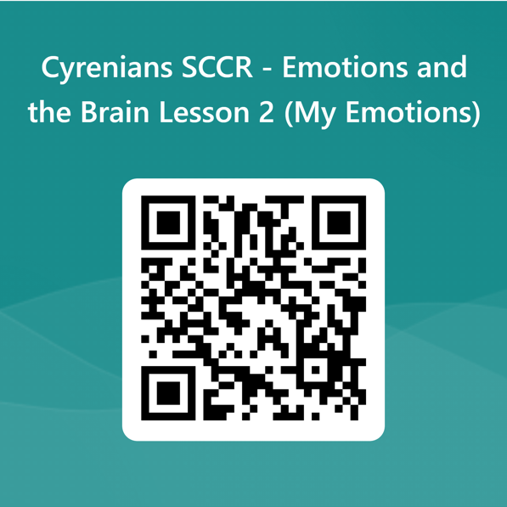
Tell us what you thought!
Stay Connected!
sccrcentre
sccrcentre
@sccrcentre
sccr@cyrenians.scot
scottishconflictresolution.org.uk
Notes:
Please encourage pupils to give feedback if they have any.

