Slide 1
Session 1: My Brain
Notes:
For more information on the brain visit the SCCR professionals learning zone for guided PowerPoints and articles: https://www.scottishconflictresolution.org.uk/learning-zone-professionals

Slide 2
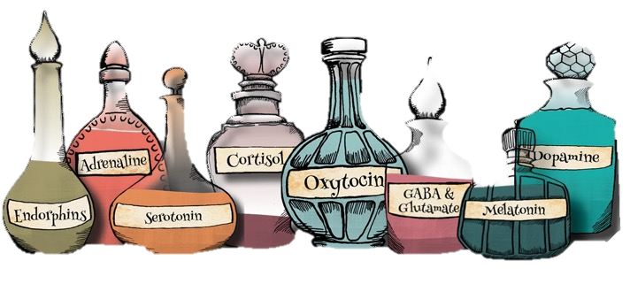
Learning Objectives:
Name the parts of the brain and describe their roles
2. Explain how and why they respond to conflict differently
3. Name the 5 emotional states
4. Explain the importance of chemicals in the brain
Notes:
Lesson aim: To increase understanding of brain development, emotional states and neurochemicals and how these affect our behaviours.

Slide 3
Warm Up Activity:
You are watching TV and your sibling/friend grabs the remote and changes the channel.
Snatch the remote back.
Ask if you can finish watching your show first.
A = Sit Down B = Stay Standing
Notes:
Instructions:
Ask pupils to stand up
Read the scenario. Explain that there are lots of ways to respond in scenarios like this but ask them to pick one of the two options.
Ask them to sit down if they would do option A and stay standing if they would do option B
Explain that everyone sitting down just used their lizard brain, and everyone standing up just used their monkey brain to respond.
Now we are going to learn more about what the Monkey and Lizard brain are.

Slide 4
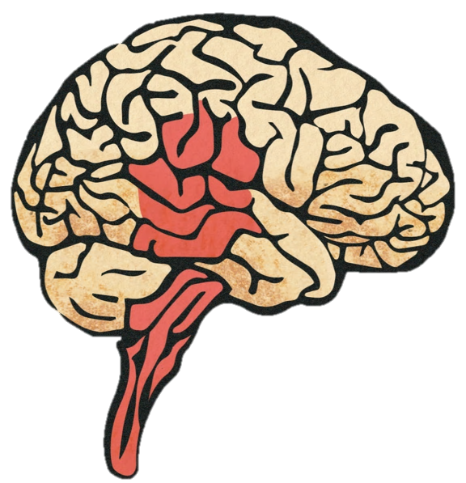
Getting to Know Your Brain
Watch the video:
https://www.scottishconflictresolution.org.uk/learning-zone-my-brain
Notes:
Follow the link to the SCCR learning zone and click on the “Getting to know the brain” video.

Slide 5
Activity
Monkey Vs Lizard Matching
For each of the scenarios, sort the responses into monkey and lizard responses.
Reminder
Monkey = Thoughtful, planned or empathetic response
Lizard = Instinctive, automatic, emotional response
(Workbook Exercise 1.1 OR Class Activity A1 )
Notes:
Preparation: For this activity you will need to print out class activity A1 (enough for 1 between two or 1 per small group). Cut out the responses on the second page.
Instructions:
Split the class into small groups or pairs and hand out the Class activity A1 worksheet and a set of responses.
Read through the scenarios as a class.
Ask pupils to sort the responses into monkey responses on the left of the worksheet and lizard responses on the right.
Discuss the answers.
Alternative Class Activity:
Use mini whiteboards or a piece of paper with monkey on one side and lizard on the other. Read the scenario and each response in turn and ask them to hold up which type of response they think it is.
Another option is to get the pupils to stand in a line in the centre of the room and get them to move to the left wall if they think it is the monkey and the right wall if they think it is the lizard.
Go through the answers and discuss how neither the monkey or the lizard are right all of the time. Discuss some of the more difficult ones that could be interpreted as both monkey and lizard.

Slide 6
Activity
Group Discussion
What are the pros and cons of the Lizard and Monkey brains?
(Optional: Workbook Activity 1a)
Notes:
Monkey: uses problem solving and empathy.
Pros - Good in a conflict situation as we can stop and process how we are feeling, empathise with others, and come up with solutions to resolve the conflict.
Cons – Takes more time. Sometimes we can overthink things.
Lizard: Quick, instinctive, emotion-driven reactions.
Pros: Good in dangerous situations and when we need to respond quickly. Sometime our instinctive reaction is the most honest.
Cons: It difficult to see the other person’s point of view in a conflict situation and we can say and do things that we might regret if we are not in control of our emotions.

Slide 7
The Teenage Brain
Watch the video:
https://www.scottishconflictresolution.org.uk/learning-zone-my-brain
Notes:
Follow the link to the SCCR learning zone and scroll down to the “Brain Development: the teenage brain” video.

Slide 8
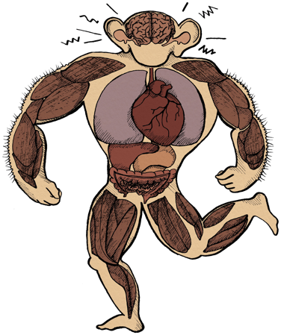
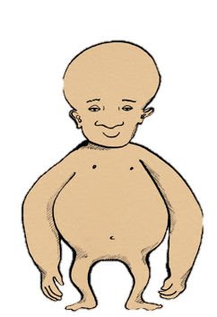
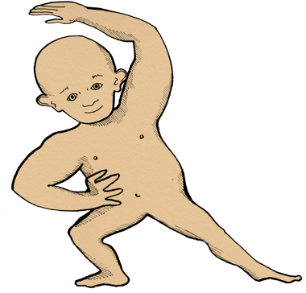
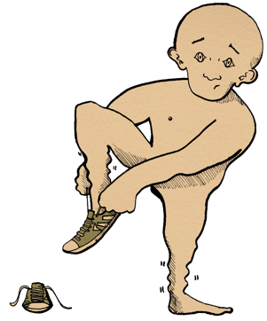
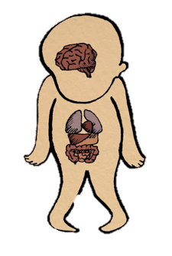
Emotional States
Watch the video:
https://www.scottishconflictresolution.org.uk/learning-zone-my-brain
(Optional: Workbook Activity 1b)
Notes:
Follow the link to the SCCR learning zone and scroll down to the “Emotional States” video.
If you are completing the optional workbook activity 1B, where pupils think of a time they have been in each emotional state, you can do this by pausing the video after each example is given for Sammy’s day, or you can watch the video to the end and then ask pupils to complete the activity.
Similarly, if you are going through the powerpoint instead of the video you can ask pupils to complete the activity as you go through each state.

Slide 9
Emotional States
A combination of emotions, body sensations and brain chemicals.
Shaped by our past experiences
Guide our actions and how we interact with the world around us.
Notes:
To learn more about emotional states visit the SCCR cranial cocktail digital resource https://www.scottishconflictresolution.org.uk/homunculus

Slide 10
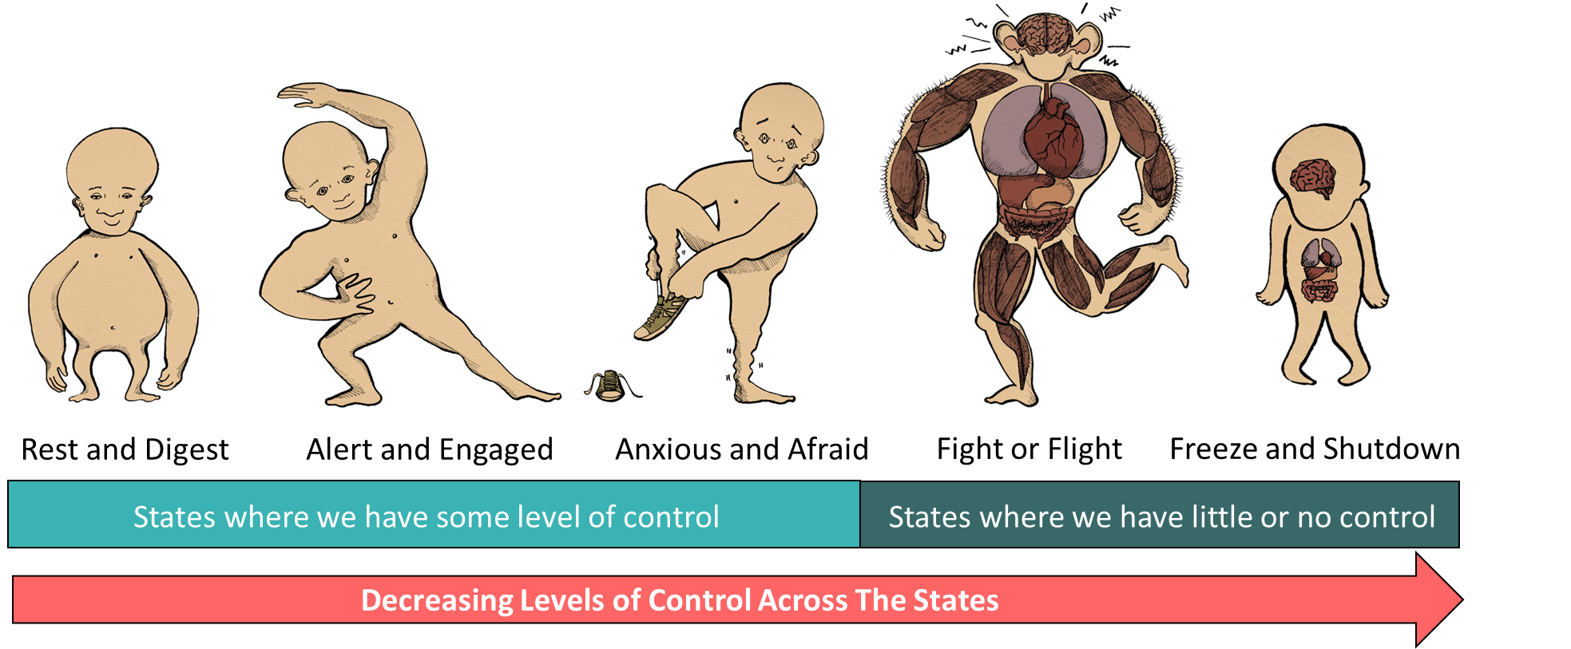
Emotional States
Notes:
We move through different emotional states throughout the day and can be in more than one at once, so our body might be in rest and digest but our mind is alert and engaged.
Emotional states are different to individual emotions. For example, we can be in our fight or flight emotional state, be we are feeling a range of emotions such as fear, anger, and rejection.
When we are in Fight or Fight and Freeze and Shutdown we have little or no control over our emotions and reactions – it’s our lizard brain kicking in.

Slide 11
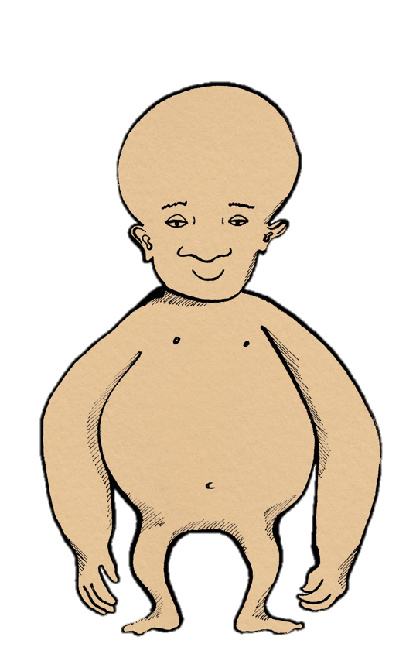
Rest and Digest
Eyelids heavy
My brain and body are recharging
I’m open to affection and new ideas
Slow breathing
Relaxed muscles
Oxygen is directed to the digestive system
“I’m chilled out. I feel relaxed and content”
Notes:
What’s happens in the body?
- Our muscles feel relaxed, we might move slower while our body is recharging and digesting, and we breathe slower. We feel safe and comfortable
When might you be in this state?
- When we are doing something we enjoy or around people we love but don’t need a lot of energy.
How are we positioned to respond to conflict in this state?
- We are open and empathetic in this state so we are able to manage conflict, however we might not be able to respond quickly. We are feeling open and safe so this might be a good time to have a difficult conversation.

Slide 12
Alert and Engaged
My senses are heightened
Muscles are relaxed but ready for action
Even breathing and heart pumping oxygen
I feel optimistic and ready for anything
“I’m excited and ready for action”
Notes:
What’s happens in the body?
- We are still relaxed but beginning to prepare for action. Our body feels awake and energised but still safe.
When might you be in this state?
- When you are doing something that your enjoy that requires energy. We are able to concentrate and ready to get things done.
How are we positioned to respond to conflict in this state?
- When we are alert and engaged we are in a good position to problem solve, consider all perspectives, and collaborate.

Slide 13
Anxious and Afraid
Heart beating fast
Preparing for danger
Sinking feeling
Tight chest
Selective senses
Breathing faster
“I feel like something bad is going to happen”
Notes:
What happens in the body?
Our breathing and heartrate increase. We might start sweating, have a sinking feeling in our stomach, or feel a tightness in the chest.
When might you be in this state?
When something happens to make you feel anxious, for example before an exam or when you are somewhere unfamiliar
How might we respond to conflict in this state?
- We are still in control in this state but we have to be careful not to flip over into fight or flight. This might not be the best time to have a difficult conversation.

Slide 14
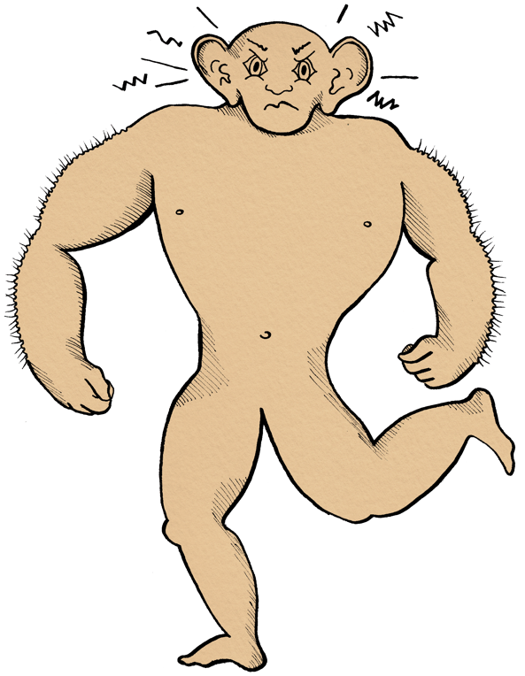
Fight or Flight
Heart thumping
Muscles are tensing
Breathing fast
Oxygen is directed to the muscles
Senses are heightened and looking for danger
“I feel afraid, but I look angry ”
Notes:
What happens in the body?
Muscles tense, blood pumping, breathing faster and senses are looking for danger.
When might you be in this state?
When something has scared you for example walking down the street alone at night.
How might we respond to conflict in this state?
- We will act instinctively and night argue or say things without thinking. It is difficult to see the other persons point of view.

Slide 15
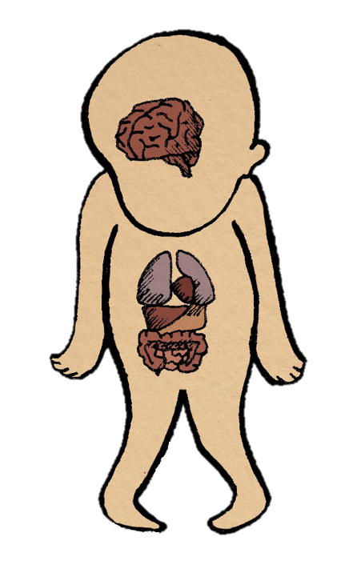
Freeze and Shutdown
Senses go numb
Weak Muscles
Digestion and cognitive function slow down
Breathing slows
Reserving energy
Heartrate decreases
“I want to be invisible. I am in survival mode ”
Notes:
What happens in the body?
Body processes slow down and you try to make yourself small.
When might you be in this state?
When you are completely overwhelmed, think of a rabbit in the headlights situation .
How might we respond to conflict in this state?
- It is very difficult to respond to conflict when we are in this state. We are not in control and it can be difficult to get our point across or listen to others.

Slide 16
Brain Chemicals
Chemicals in our brain are called neurochemicals or neurotransmitters.
They affect how we think, feel and act.
Different combinations of chemicals are related to different emotional states.
Notes:
For more information on brain chemicals try looking at the cranial cocktail resource on the SCCR website: https://www.scottishconflictresolution.org.uk/homunculus be careful not to give away the answers to the next activity by telling the class which chemicals are in which emotional state.
For more information on the brain visit the SCCR professionals learning zone for guided PowerPoints and articles: https://www.scottishconflictresolution.org.uk/learning-zone-professionals

Slide 17
Activity
What’s in the brain?
For each scenario, choose the emotional state you would most likely be in, then find the chemicals that match that state.
(Workbook Exercise 1.2 OR Class Activity A2 )
Notes:
PURPOSE:
To learn what different brain chemicals do and which brain chemicals are associated with the different emotional states.
PREPARATION:
Print two sets of: emotional state cards, brain
chemical cards and scenario cards.
INSTRUCTIONS:
Split the class into two groups and give each group a set of emotional state cards and brain chemical cards.
Place two sets of scenario cards (shuffled) at the front of the class.
Divide the brain cards within the groups and ask the pupils to read through their card - they are the expert on that brain chemical.
Assign a runner for each group to come and collect a scenario from the front of the class and bring it back to their group.
As a group, pupils need to decide which state and brain chemicals match the scenario.
Experts can tell the rest of the group what their chemical does and if they think it matches the state.
Once a decision has been made, the runner takes the scenario, state card and brain chemical cards back to the front of the class for the teacher to check.
If they have the right combination the runner takes the next scenario. If they got it wrong the runner takes back the wrong cards until they get the right answer.
The first team to complete all the scenarios wins.
Go over the answers at the end.

Slide 18
Learning Objectives:
Name the parts of the brain and describe their roles
2. Explain how and why they respond to conflict differently
3. Name the 5 emotional states
4. Explain the importance of chemicals in the brain
Notes:
We have a Lizard Brain (Limbic system + brain stem) and a Monkey Brain (Prefrontal Cortex).
Lizard Brain is responsible for automatic, emotion-driven responses, good in dangerous situations. Monkey Brain is responsible for evaluating, reflecting, problem solving and empathising, which can help resolve conflict.
Most of the time the Monkey Brain is in control of the Lizard Brain. In a conflict situation, the Monkey Brain can help us see the other person’s point of view and solve the problem. However, if the Monkey and Lizard Brain lose connection and the Lizard Brain takes over, we are overwhelmed with emotion and can go into Fight or Flight or Freeze and Shutdown states leading to more impulsive actions.
The Emotional States are: Rest and Digest, Alert and Engaged, Anxious and Afraid, Fight or Flight, and Freeze and Shutdown.
We have lots of different brain chemicals that drive our emotional states and guide our behaviour.

Slide 19
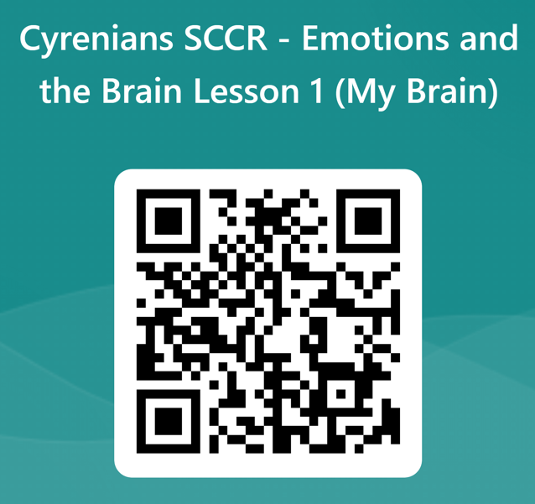
Tell us what you thought!
Stay Connected!
sccrcentre
sccrcentre
@sccrcentre
sccr@cyrenians.scot
scottishconflictresolution.org.uk

