Slide 1
Session 3:
MY WELLBEING

Slide 2
LEARNING AIMS:
Describe what coping skills are.
Know the difference between emotion, thought and problem focused approaches.
List some things you can try to help soothe your emotions and boost your mood.
Explain why it might be important to “sit with” an emotion.
Describe what is meant by unhelpful thinking and intrusive thoughts.

Slide 3
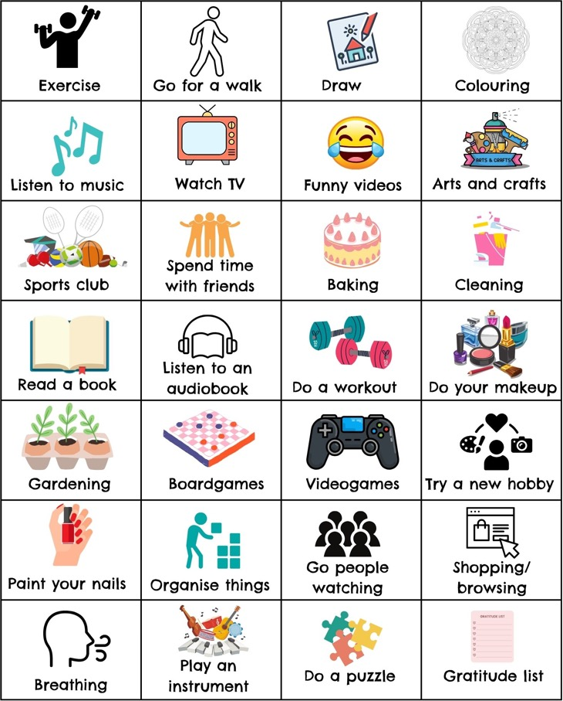
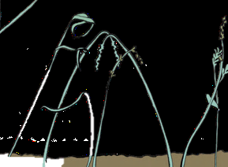
WHAT ARE COPING SKILLS?
Coping skills are things that we do to help deal with stress or other difficult situations and emotions.
Practicing healthy coping skills helps build resilience and has a positive impact on our wellbeing.

Slide 4
Choosing a Coping Skill:
EMOTION vs THOUGHT vs PROBLEM
Focus on the emotion, can we soothe, process or express it?
Focus on the thought, can we change the way we are thinking about the situation?
Focus on the situation, can we change it or make it easier?
Notes:
When we find ourselves in a difficult situation we can take a problem-focused approach, emotion-focused approach or a thought-focused approach. With a problem-focused approach we aim to tackle the problem itself, whereas an emotion-focused approach helps us deal with the the feelings that the problem is causing. Sometimes we do a bit of both. For example, if you are someone who gets anxious in exams, you might make a timetable for revision (problem-focused) while also practicing some breathing exercises to relax before the exam (emotion-focused). A thought-focused approach helps us change the way we think about the problem, so we might think about the exam as a chance to show our learning rather than as a test.

Slide 5
1. EMOTION FOCUS
Respond to emotion
Accept and sit with emotion
Express
Notes:
If we are experiencing uncomfortable emotions such as sadness, worry or anger, we can decide to respond to it by using coping strategies to soothe or boost, to express the emotions (verbally, physically or creatively) or to accept and process the emotion by exploring it more and allowing ourselves to feel the emotion fully.

Slide 6
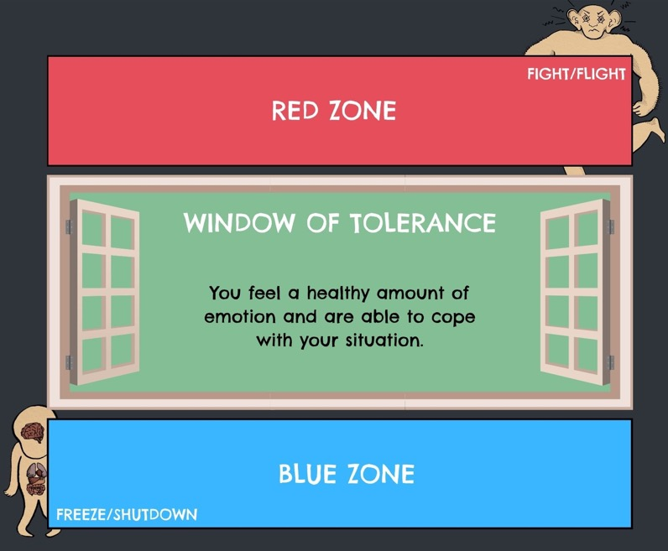
Responding to Emotions
Soothe Emotions
Reduce cortisol and adrenaline with calming exercises like breathing and grounding
Boost Mood
Things that boost serotonin, endorphins and oxytocin like seeing friends or doing a hobby

Slide 7
ACTIVITY: Post-it Note
What boosts your mood? What calms you down?
Notes:
Hand out two post-it notes to each pupil (ideally using two different colours).
Ask pupils to write down something that boosts their mood on one colour post-it note and something that helps calm them down on the other.
Ask pupils to display these on the board.
Discuss some of the answers or common themes.

Slide 8
How do coping skills work?
BREATHING
GROUNDING
EXERCISE
DISTRACTION
Notes:
Breathing increases oxygen levels and lowers blood pressure, heartrate and cortisol levels.
Grounding techniques help bring you attention away from negative thoughts and memories. They often focus on our senses to bring our attention to the present moment.
Exercise releases endorphins, dopamine and serotonin which boosts our mood.
Distractions such as puzzles or other hobbies helps engage the thinking brain allowing us to stay in control of our emotions

Slide 9
OPTIONAL ACTIVITY: Grounding Technique
Try a grounding technique now
(Workbook Activity 3a)

Slide 10
Helpful vs Unhelpful Coping
Unhelpful coping strategies often are not effective in the long term and can have a negative impact on our wellbeing, even if they seem like they are helping at the time.
Sometimes healthy coping strategies can become unhealthy if we do them too much.
Notes:
Any coping strategy can be unhelpful if used in excess e.g. exercising, eating, sleeping. Encourage pupils to consider if the strategy is helpful immediately or long term, temporarily or permanently. Ask if the strategy just helps them to “cope” , if it has a wider positive impact on their wellbeing, or if it helps them to address the root cause of the problem.)

Slide 11
ACTIVITY: Discuss in pairs
Can you think of an example of a helpful and unhelpful coping strategy?

Slide 12
ACTIVITY: Coping Skills
What works for you? Make a playlist, exercise routine or journal template.

Slide 13
Expressing Emotions
There are lots of ways to express our emotions. We might express them differently at different times.
Notes:
There are different ways to express emotions, we might write them down, talk about them, or express them through movement or creativity.

Slide 14
Sitting with Emotions
Sometimes it’s not possible to change how we feel and we might need time to process our emotions.
Sitting with an emotion means letting yourself feel the emotion fully and accepting it.
Notes:
A good example of this is processing loss or grief.

Slide 15
ACTIVITY: Discussion
When might you need to sit with an emotion? (give an example)
Why is it important to sit with emotions?

Slide 16
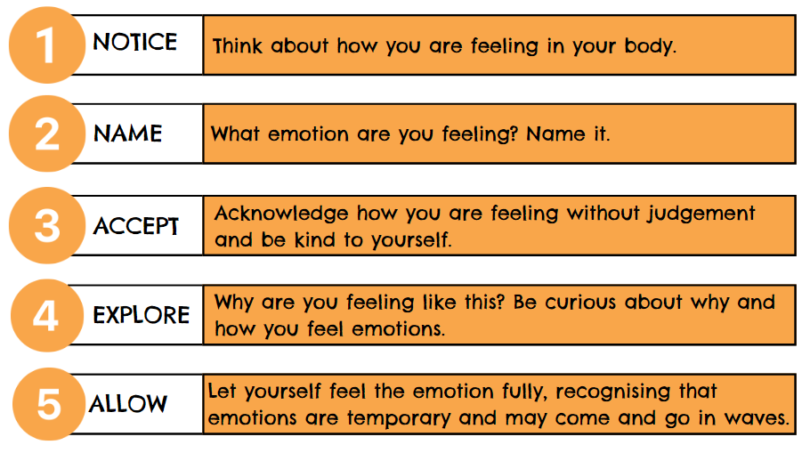
How to sit with emotions

Slide 17
2. THOUGHT APPROACH
Sometimes it is the way we are thinking about a problem that is causing us emotional distress
Notes:
Difficult emotions can come from the way we think and we may need to challenge our thoughts or learn how to separate thoughts from facts.

Slide 18
Unhelpful Thinking Patters:
Notes:
All or nothing: a type of extreme thinking where you might categorise things as either a success or a failure, there is no in between. Eg only being satisfied with 100% in an exam. Anything below you see as a failure. Thinking like this can cause you to be overcritical of yourself, give up easily, or be reluctant to try new things. One way to challenge this thinking style is to make a list of some alternatives that fall.
Saying things like “I must do this” or “I should have done that” can lead to unrealistic expectations. When these expectations aren’t met you might feel disappointed, be overly critical of yourself, or lose confidence.
Mental filter: focusing on the negatives and discard all the positives. To break this pattern of thinking you could try a thought challenge exercise where you write down the evidence for and against the negative thought, or try writing a daily gratitude and positive affirmation journal.
Catastrophising: thinking the worst possible thing has happened, or is about the happen, when most of the time this is not the case. These thoughts can make us feel anxious and worry about things that are unlikely to happen. If we have these thoughts it’s important to take a step back and think about the best possible outcome as well as the worst. Then we can see what the most likely outcome is, often this will be somewhere in between.
Jumping to conclusions: making assumptions without evidence. These are often negative. To challenge this, you can do a fact vs opinion/thought check. Do you have evidence that confirms it is a fact or could you be jumping to conclusions?
Personalisation: incorrectly assuming something is our fault, or take responsibility for something out of our control. Challenge negative thoughts about ourselves by reminding ourselves that these are often just thoughts or opinions and not facts. Practice positive self-talk and try to recognise the difference between things that are inside and outside of your control. ­­

Slide 19
Fact Vs Opinion
Sometimes when we are under a lot of stress, we can be driven more by our emotions and opinions. Knowing the difference between thoughts that are facts and thoughts that are opinions can help us respond more calmly and rationally.

Slide 20
ACTIVITY:
Try Fact and Opinion thought challenge now
(Workbook Activity 3c)

Slide 21
Intrusive Thoughts:
Unwanted thoughts that can pop into our heads without warning, at any time.
Often repetitive
Can be disturbing or distressing.
Many people have these, it is normal

Slide 22
Dealing with intrusive thoughts:
Question 1: Is it a thought or a fact?
Question 2: Is it helpful or unhelpful?

Slide 23
LEARNING AIMS:
Describe what coping skills are.
Know the difference between emotion, thought and problem focused approaches.
List some things you can try to help soothe your emotions and boost your mood.
Explain why it might be important to “sit with” an emotion.
Describe what is meant by unhelpful thinking and intrusive thoughts.
Notes:
Coping skills are things we can do to deal with stress or other difficult situations and emotions.
We can take an emotion-focused approach by responding, expressing or sitting with our emotions. A problem-focused approach targets the situation or trigger that is causing the emotion. A thought-focused approach aims to change the way we are thinking about the problem and challenge negative thoughts that are causing distress.
There are lots of things we can do to soothe our emotions or boost our mood such as breathing and grounding techniques, exercising, hobbies that we enjoy, hanging out with friends and family, journaling, or talking to someone about how we feel.
Sometimes we need to “sit with” emotions so that we are able to process and feel them fully. If we ignore our emotions they may come out in less healthy ways. Sitting with emotions builds self-awareness.
Unhelpful thinking styles include: All or nothing thinking, having a mental filter, catastrophising, jumping to conclusions, overusing should/must, and over personalising. Being aware of these and challenging them can change the way we think about a situation, reduce stress and improve mood.
Intrusive thoughts are thoughts that we can’t control. They pop into our head and cause distress. We can acknowledge that they are just thoughts and not facts and we do not need to act on them.

Slide 24
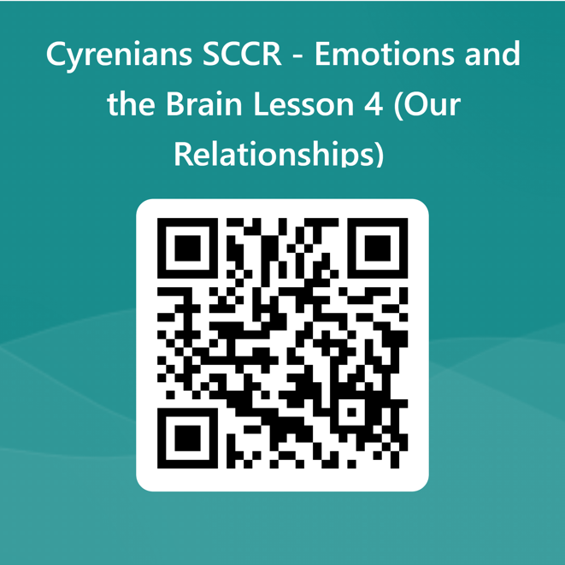
Tell us what you thought!
Stay Connected!
sccrcentre
sccrcentre
@sccrcentre
sccr@cyrenians.scot
scottishconflictresolution.org.uk
Notes:
Please encourage pupils to give feedback if they have any.

